Slide 1
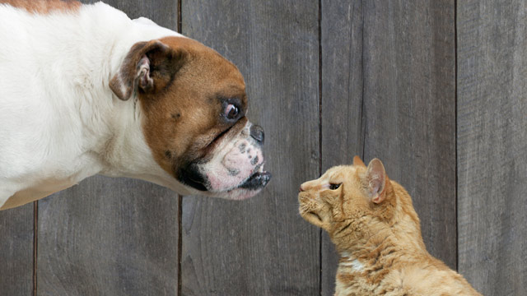
Category Recognition
Jia-Bin Huang
Virginia Tech
ECE 6554 Advanced Computer Vision

Slide 2
Administrative stuffs
Presentation and discussion leads assigned
Questions?

Slide 3
Today’s class
Finish instance recognition
Category recognition
Convolutional neural network

Slide 4
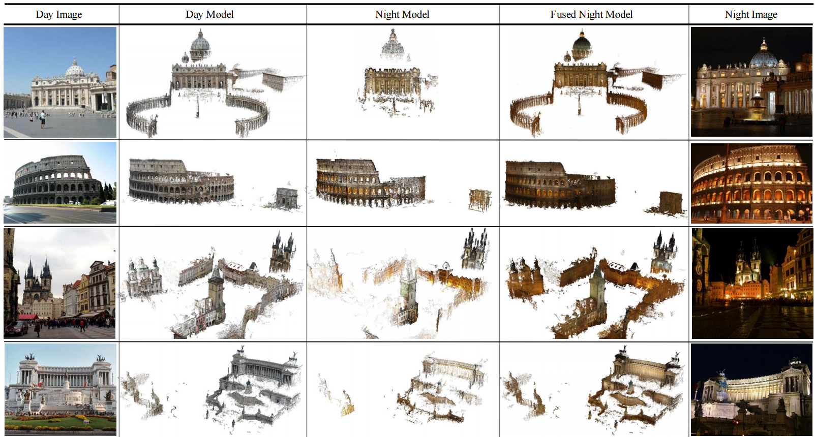
From Dusk till Dawn: Modeling in the Dark, CVPR 2016

Slide 5
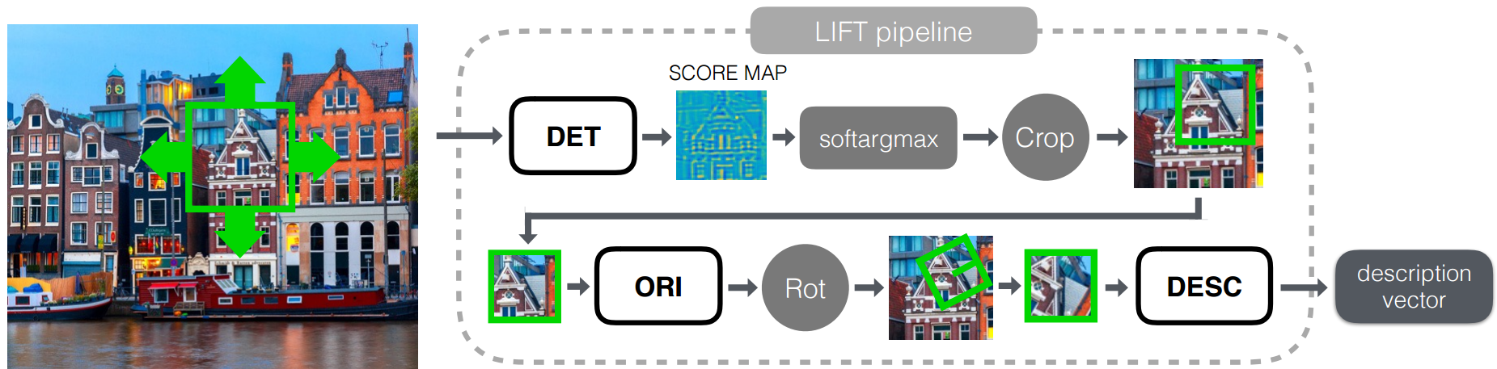
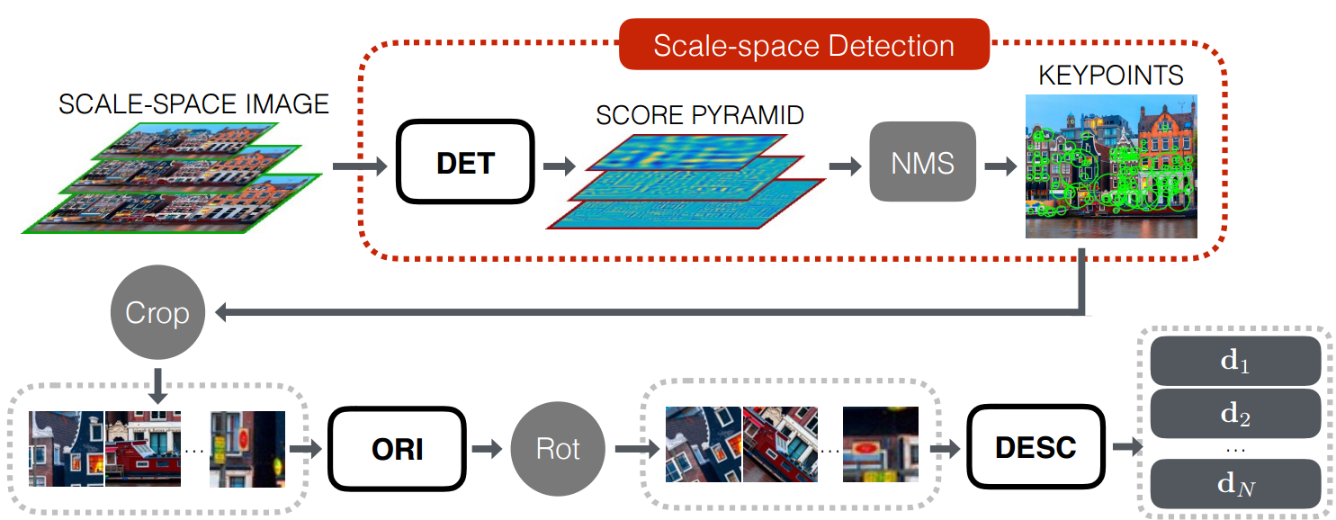
Lift: Learned invariant feature transform, ECCV 2016

Slide 6
Instance recognition
Motivation – visual search
Visual words
  quantization, index, bags of words
Spatial verification
  affine; RANSAC, Hough
Other text retrieval tools
  tf-idf, query expansion
Example applications

Slide 7
Instance recognition: remaining issues
How to summarize the content of an entire image? And gauge overall similarity?
How large should the vocabulary be? How to perform quantization efficiently?
Is having the same set of visual words enough to identify the object/scene? How to verify spatial agreement?
How to score the retrieval results?
Kristen Grauman

Slide 8
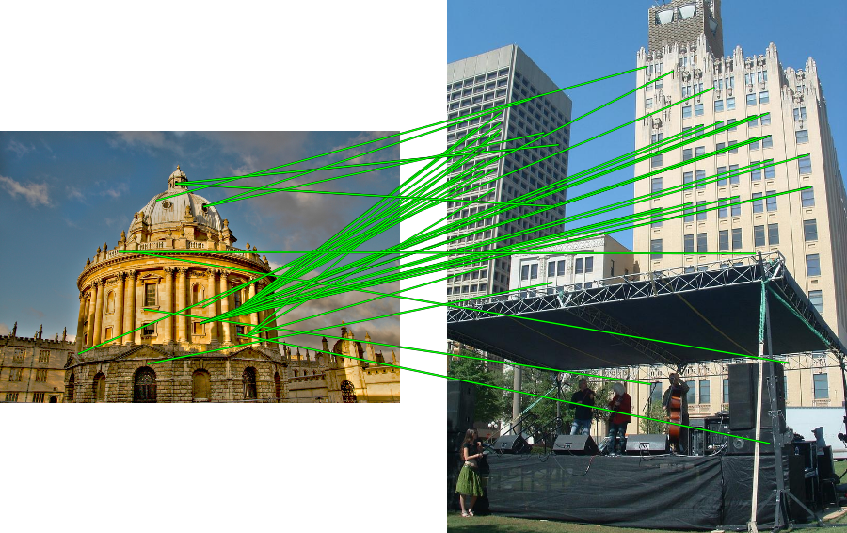
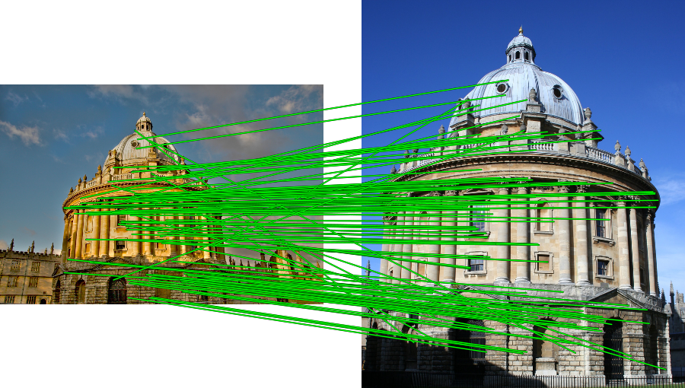
Spatial Verification
Query
Query
DB image with high BoW similarity
DB image with high BoW similarity
Both image pairs have many visual words in common.
Slide credit: Ondrej Chum

Slide 9
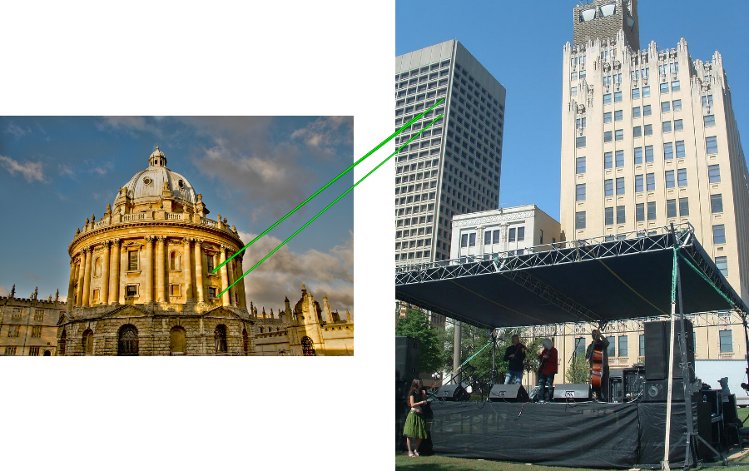
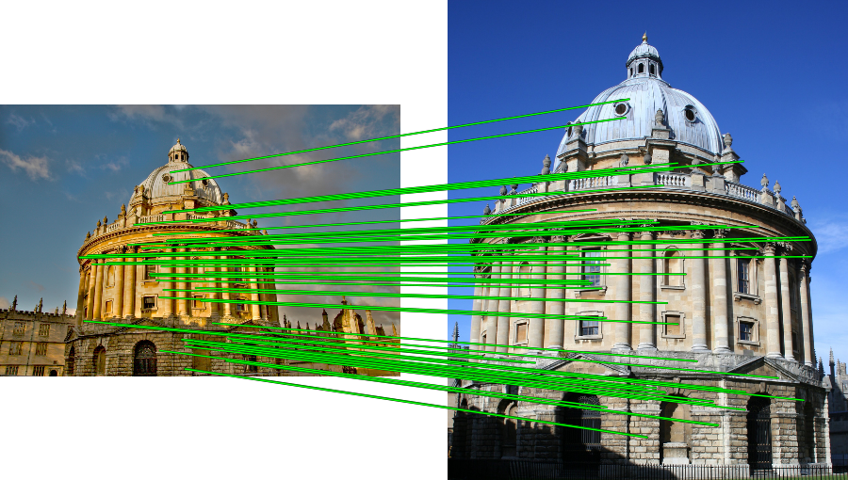
Spatial Verification
Query
Query
DB image with high BoW similarity
DB image with high BoW similarity
Only some of the matches are mutually consistent
Slide credit: Ondrej Chum

Slide 10
Spatial Verification: two basic strategies
RANSAC
  Typically sort by BoW similarity as initial filter
  Verify by checking support (inliers) for possible transformations
    e.g., “success” if find a transformation with > N inlier correspondences
Generalized Hough Transform
  Let each matched feature cast a vote on location, scale, orientation of the model object
  Verify parameters with enough votes
Kristen Grauman

Slide 11
RANSAC verification

Slide 12
Recall: Fitting an affine transformation
Approximates viewpoint changes for roughly planar objects and roughly orthographic cameras.

Slide 13
RANSAC verification

Slide 14

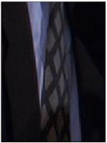
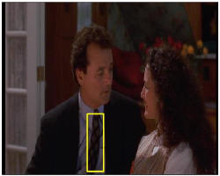
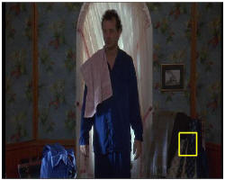
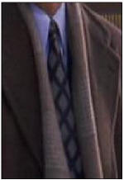
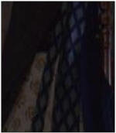
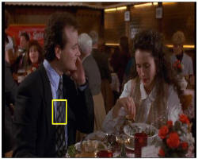
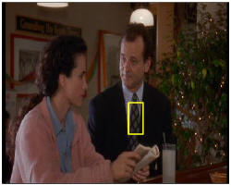

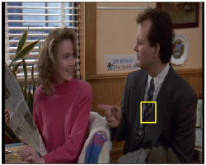
Video Google System
Query region
Collect all words within query region
Inverted file index to find relevant frames
Compare word counts
Spatial verification
Sivic & Zisserman, ICCV 2003
Demo online at : http://www.robots.ox.ac.uk/~vgg/research/vgoogle/index.html
Retrieved frames
Kristen Grauman
Notes:
14

Slide 15
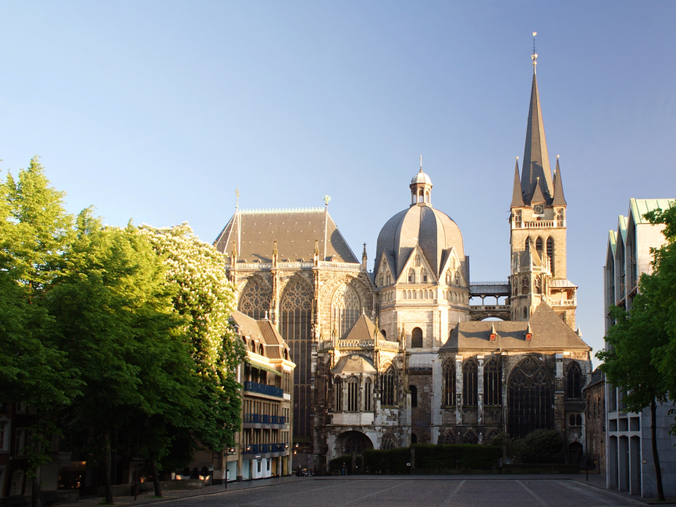
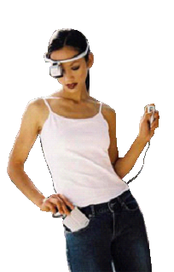
Example Applications
Aachen Cathedral
Mobile tourist guide
Self-localization
Object/building recognition
Photo/video augmentation
[Quack, Leibe, Van Gool, CIVR’08]

Slide 16
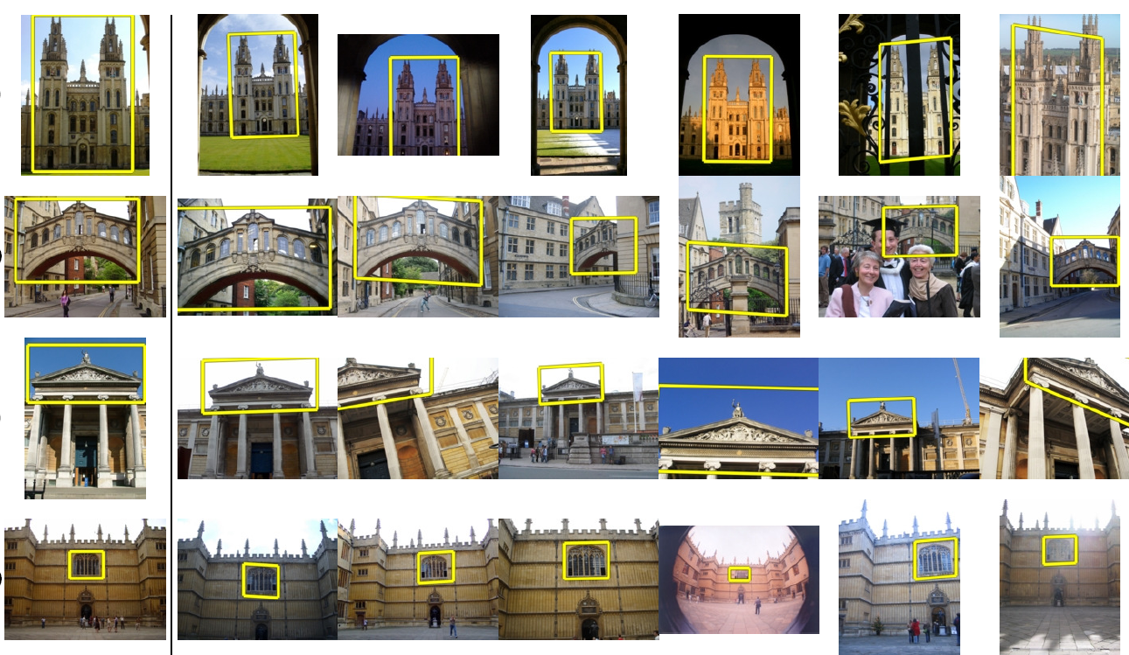
Application: Large-Scale Retrieval
Query
Results from 5k Flickr images (demo available for 100k set)
[Philbin CVPR’07]

Slide 17

Web Demo: Movie Poster Recognition
50’000 movie
posters indexed
Query-by-image
from mobile phone
available in Switzer-
land
http://www.kooaba.com/en/products_engine.html#

Slide 18
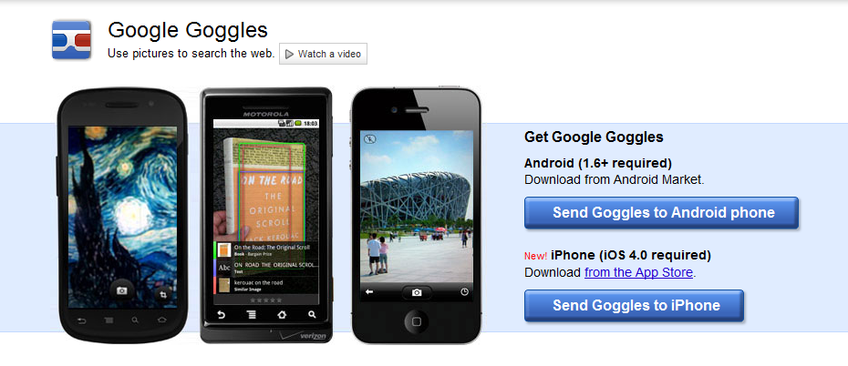
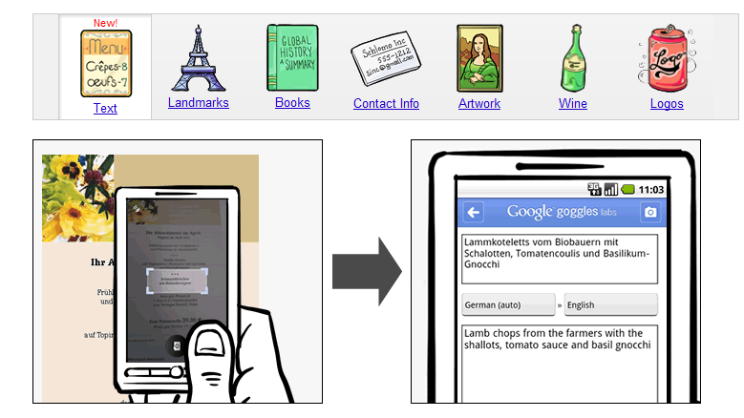
Notes:
http://www.google.com/mobile/goggles

Slide 19
Spatial Verification: two basic strategies
RANSAC
  Typically sort by BoW similarity as initial filter
  Verify by checking support (inliers) for possible transformations
    e.g., “success” if find a transformation with > N inlier correspondences
Generalized Hough Transform
  Let each matched feature cast a vote on location, scale, orientation of the model object
  Verify parameters with enough votes
Kristen Grauman

Slide 20
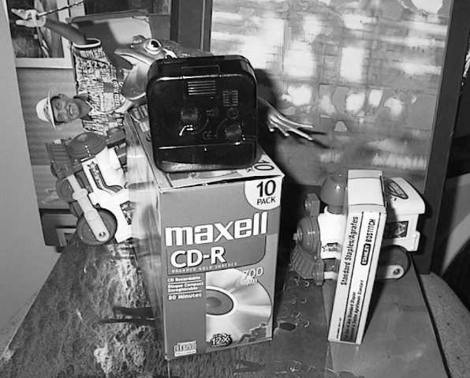
Voting: Generalized Hough Transform
If we use scale, rotation, and translation invariant local features, then each feature match gives an alignment hypothesis (for scale, translation, and orientation of model in image).
Model
Novel image
Adapted from Lana Lazebnik

Slide 21
Voting: Generalized Hough Transform
A hypothesis generated by a single match may be unreliable,
So let each match vote for a hypothesis in Hough space
Model
Novel image

Slide 22
Gen Hough Transform details (Lowe’s system)
Training phase: For each model feature, record 2D location, scale, and orientation of model (relative to normalized feature frame)
Test phase: Let each match btwn a test SIFT feature and a model feature vote in a 4D Hough space
  Use broad bin sizes of 30 degrees for orientation, a factor of 2 for scale, and 0.25 times image size for location
  Vote for two closest bins in each dimension
Find all bins with at least three votes and perform geometric verification
  Estimate least squares affine transformation
  Search for additional features that agree with the alignment
David G. Lowe. "Distinctive image features from scale-invariant keypoints.” IJCV 60 (2), pp. 91-110, 2004.
Slide credit: Lana Lazebnik

Slide 23
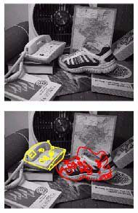
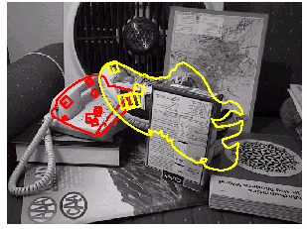
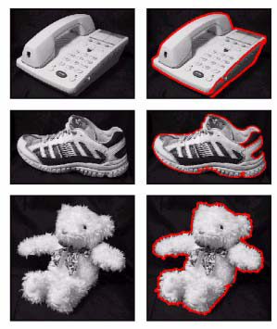
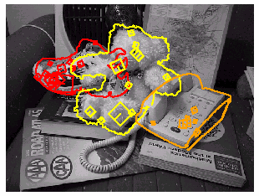
Example result
Background subtract for model boundaries
Objects recognized,
Recognition in spite of occlusion
[Lowe]

Slide 24
Recall: difficulties of voting
Noise/clutter can lead to as many votes as true target
Bin size for the accumulator array must be chosen carefully
In practice, good idea to make broad bins and spread votes to nearby bins, since verification stage can prune bad vote peaks.

Slide 25
Gen Hough vs RANSAC
GHT
Single correspondence -> vote for all consistent parameters
Represents uncertainty in the model parameter space
Linear complexity in number of correspondences and number of voting cells; beyond 4D vote space impractical
Can handle high outlier ratio
RANSAC
Minimal subset of correspondences to estimate model -> count inliers
Represents uncertainty in image space
Must search all data points to check for inliers each iteration
Scales better to high-d parameter spaces
Kristen Grauman

Slide 26
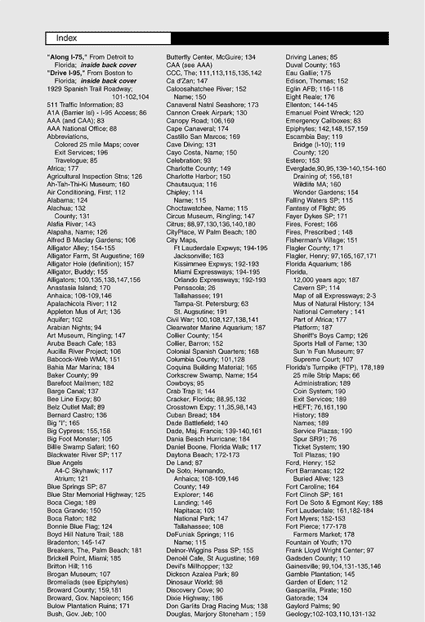

What else can we borrow from text retrieval?
China is forecasting a trade surplus of $90bn (£51bn) to $100bn this year, a threefold increase on 2004's $32bn. The Commerce Ministry said the surplus would be created by a predicted 30% jump in exports to $750bn, compared with a 18% rise in imports to $660bn. The figures are likely to further annoy the US, which has long argued that China's exports are unfairly helped by a deliberately undervalued yuan. Beijing agrees the surplus is too high, but says the yuan is only one factor. Bank of China governor Zhou Xiaochuan said the country also needed to do more to boost domestic demand so more goods stayed within the country. China increased the value of the yuan against the dollar by 2.1% in July and permitted it to trade within a narrow band, but the US wants the yuan to be allowed to trade freely. However, Beijing has made it clear that it will take its time and tread carefully before allowing the yuan to rise further in value.
China, trade,
surplus, commerce,
exports, imports, US,
yuan, bank, domestic,
foreign, increase,
trade, value

Slide 27
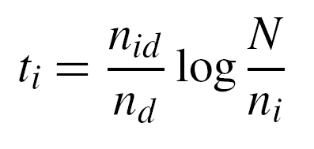
tf-idf weighting
Term frequency – inverse document frequency
Describe frame by frequency of each word within it, downweight words that appear often in the database
(Standard weighting for text retrieval)
Number of occurrences of word i in document d
Total number of documents in database
Number of documents word i occurs in, in whole database
Number of words in document d
Kristen Grauman

Slide 28
Query expansion
Query: golf green
Results:
- How can the grass on the greens at a golf course be so perfect?
For example, a skilled golfer expects to reach the green on a par-four hole in ...
- Manufactures and sells synthetic golf putting greens and mats.
Irrelevant result can cause a `topic drift’:
Volkswagen Golf, 1999, Green, 2000cc, petrol, manual, , hatchback, 94000miles, 2.0 GTi, 2 Registered Keepers, HPI Checked, Air-Conditioning, Front and Rear Parking Sensors, ABS, Alarm, Alloy
Slide credit: Ondrej Chum

Slide 29
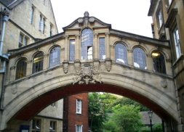
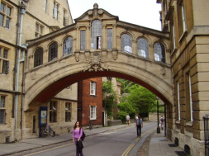
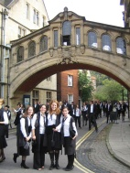
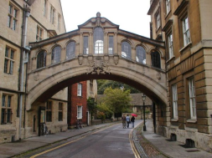
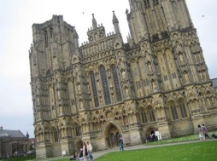
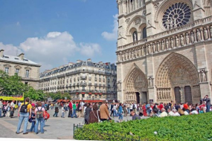
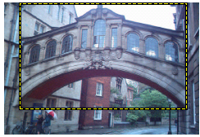
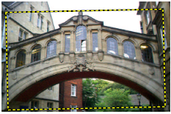
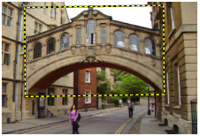
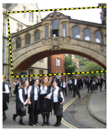
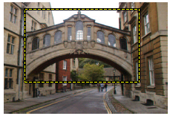
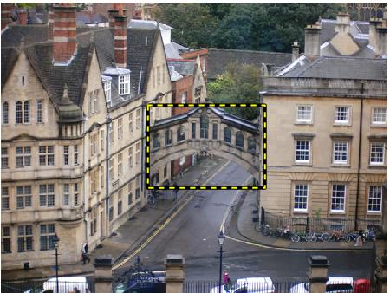
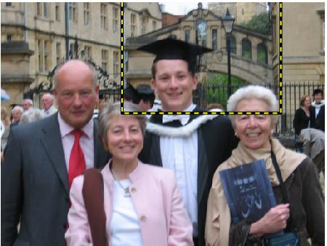
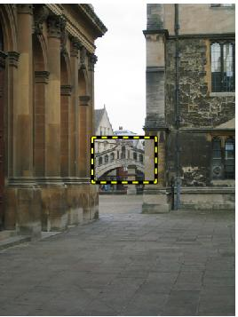
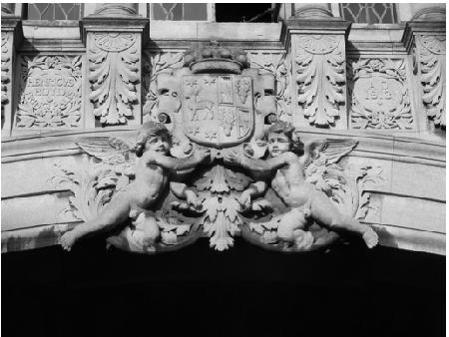
Query Expansion
Results
…
Spatial verification
Query image
New results
New query
Chum, Philbin, Sivic, Isard, Zisserman: Total Recall…, ICCV 2007
Slide credit: Ondrej Chum

Slide 30
Recognition via alignment
  Pros:
    Effective when we are able to find reliable features within clutter
    Great results for matching specific instances
  Cons:
    Scaling with number of models
    Spatial verification as post-processing – not seamless, expensive for large-scale problems
    Not suited for category recognition.
Kristen Grauman

Slide 31


Making the Sky Searchable:
Fast Geometric Hashing for Automated Astrometry
Sam Roweis, Dustin Lang & Keir Mierle
University of Toronto
David Hogg & Michael Blanton
New York University
31

Slide 32
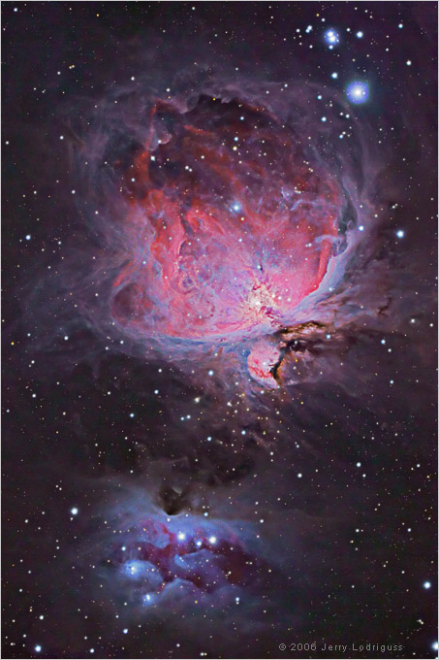
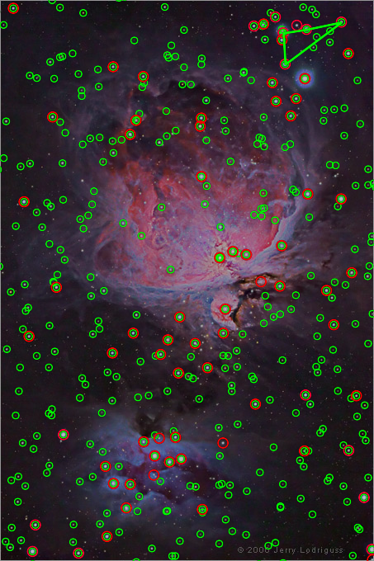
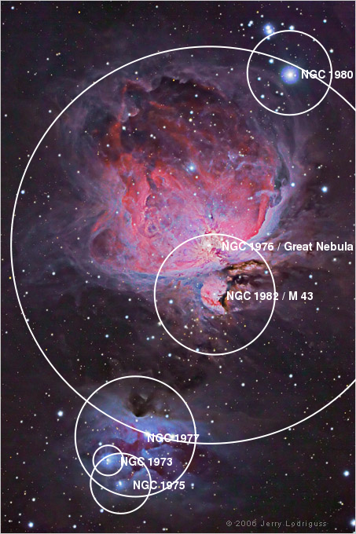
Example
A shot of the Great Nebula, by Jerry Lodriguss (c.2006), from astropix.com
http://astrometry.net/gallery.html

Slide 33
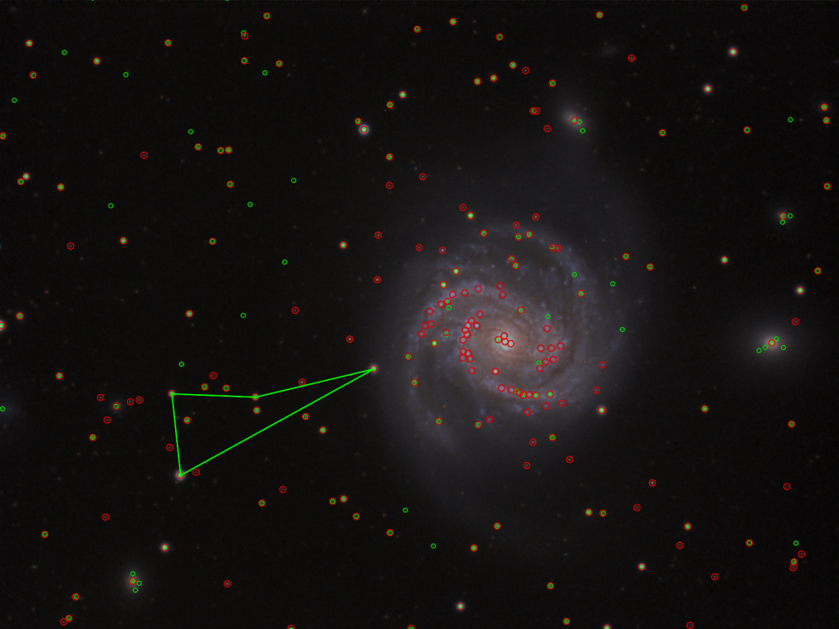
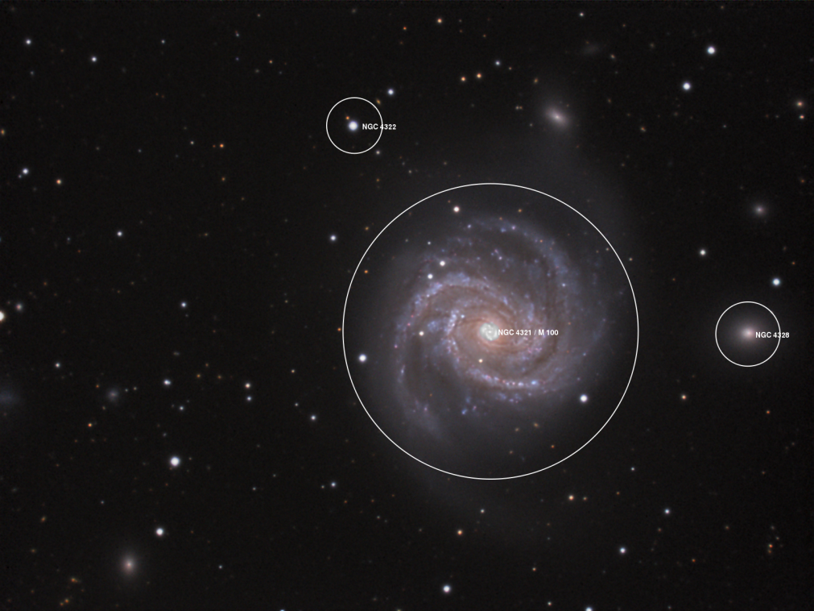
Example
An amateur shot of M100, by Filippo Ciferri (c.2007) from flickr.com
http://astrometry.net/gallery.html

Slide 34
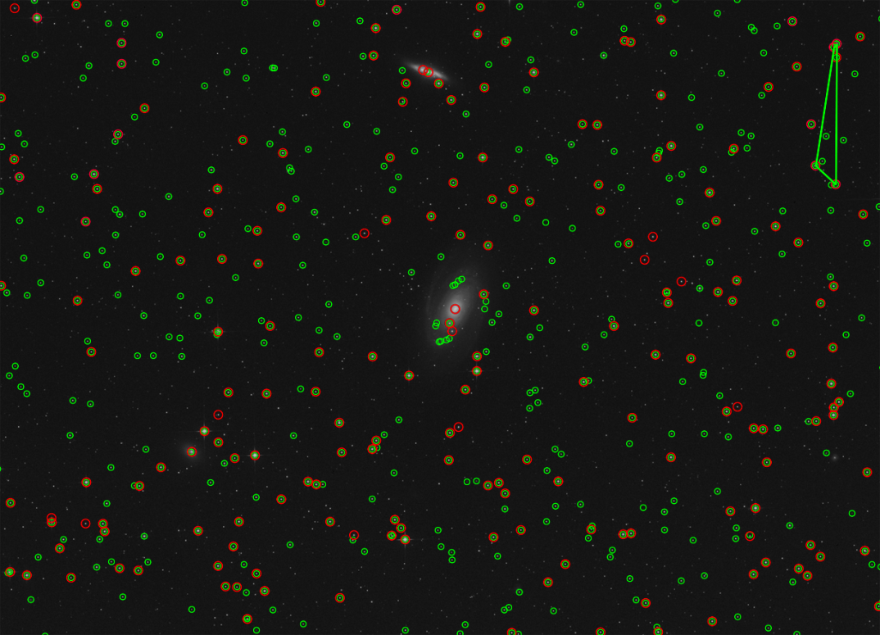
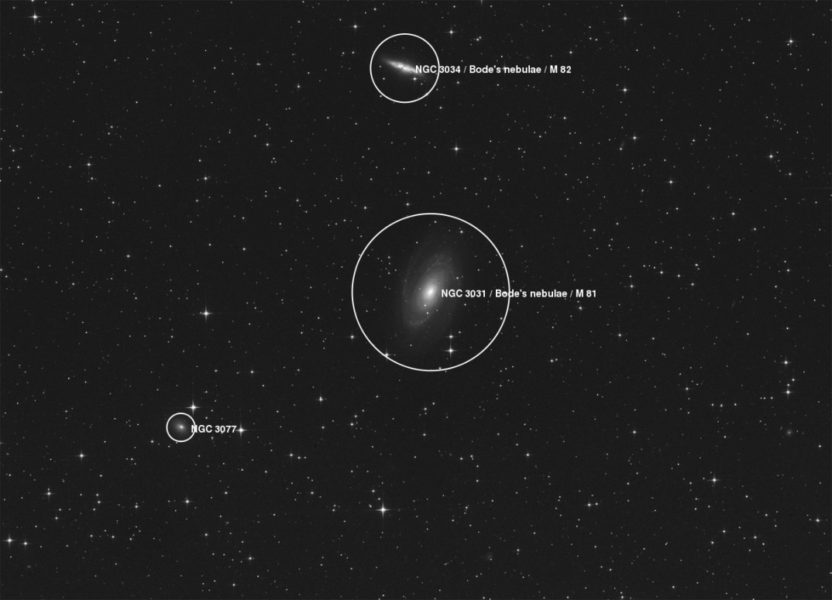
Example
A beautiful image of Bode's nebula (c.2007) by Peter Bresseler, from starlightfriend.de
http://astrometry.net/gallery.html

Slide 35
Things to remember
Matching local invariant features
  Useful not only to provide matches for multi-view geometry, but also to find objects and scenes.
Bag of words representation: quantize feature space to make discrete set of visual words
  Summarize image by distribution of words
  Index individual words
Inverted index: pre-compute index to enable faster search at query time
Recognition of instances via alignment: matching local features followed by spatial verification
  Robust fitting : RANSAC, GHT

Slide 36
Discussion – Think-pair-share
Find a person you don’t know
Discuss
  strength,
  weakness, and
  potential extension
Share with class

Slide 37




Image Categorization: Training phase
Training Images
Training
Training Labels
Image Features
Classifier Training
Trained Classifier
Notes:
Recall this image classification diagram in the previous lecture. Here we want to classify an image. We collect a dataset of examples with labels, extract some image features, train a classifier so that the prediction errors on the training images are minimized.

Slide 38

Image Categorization: Testing phase
Training Images
Training
Training Labels
Image Features
Classifier Training
Trained Classifier
Testing
Image Features
Trained Classifier
Prediction
Outdoor
Test Image
Notes:
At testing time, when given a new test image, we extract the same image features and use the trained classified for prediction.

Slide 39
Image categorization
Cat vs Dog

Slide 40

Image categorization
Object recognition
Caltech 101 Average Object Images

Slide 41

Image categorization
Fine-grained recognition
Visipedia Project

Slide 42

Image categorization
Place recognition
Places Database [Zhou et al. NIPS 2014]

Slide 43

Image categorization
Visual font recognition
[Chen et al. CVPR 2014]

Slide 44

Image categorization
Dating historical photos
1940
1953
1966
1977
[Palermo et al. ECCV 2012]

Slide 45

Image categorization
Image style recognition
[Karayev et al. BMVC 2014]

Slide 46





Features are the Keys
SIFT [Loewe IJCV 04]
HOG [Dalal and Triggs CVPR 05]
SPM [Lazebnik et al. CVPR 06]
DPM [Felzenszwalb et al. PAMI 10]
Color Descriptor [Van De Sande et al. PAMI 10]

Slide 47
Learning a Hierarchy of Feature Extractors
  Each layer of hierarchy extracts features from output of previous layer
  All the way from pixels → classifier
  Layers have the (nearly) same structure
  Image/video
  Labels
Image/Video
Pixels
Layer 1
Layer 2
Layer 3
Simple
Classifier
Notes:
Make clear that classic methods, e.g. convnets are purely supervised.

Slide 48



Biological neuron and Perceptrons
A biological neuron
An artificial neuron (Perceptron)
- a linear classifier

Slide 49



Simple, Complex and Hypercomplex cells
David H. Hubel and Torsten Wiesel
Suggested a hierarchy of feature detectors in the visual cortex, with higher level features responding to patterns of activation in lower level cells, and propagating activation upwards to still higher level cells.
David Hubel's Eye, Brain, and Vision

Slide 50


Hubel/Wiesel Architecture and Multi-layer Neural Network
Hubel and Weisel’s architecture
Multi-layer Neural Network
- A non-linear classifier

Slide 51


Multi-layer Neural Network
A non-linear classifier
Training: find network weights w to minimize the error between true training labels $y_{i}$and estimated labels $f_{w }\left(x_{i}\right)$
Minimization can be done by gradient descent provided $f$ is differentiable
This training method is called
back-propagation

Slide 52
Convolutional Neural Networks
Also known as CNN, ConvNet, DCN
CNN = a multi-layer neural network with
    1. Local connectivity
    2. Weight sharing

Slide 53
CNN: Local Connectivity
Hidden layer
Input layer
Global connectivity
Local connectivity
# input units (neurons): 7
# hidden units: 3
Number of parameters
  Global connectivity: 3 x 7 = 21
  Local connectivity: 3 x 3 = 9

Slide 54
CNN: Weight Sharing
Hidden layer
w₁
w₃
w₅
w₇
w₉
w₁
w₃
w₂
w₁
w₃
w₂
w₄
w₆
w₈
w₂
w₁
w₃
w₂
Input layer
Without weight sharing
With weight sharing
# input units (neurons): 7
# hidden units: 3
Number of parameters
  Without weight sharing: 3 x 3 = 9
  With weight sharing : 3 x 1 = 3

Slide 55
CNN with multiple input channels
Hidden layer
Input layer
Channel 1
Channel 2
Single input channel
Multiple input channels
Filter weights
Filter weights

Slide 56
CNN with multiple output maps
Hidden layer
Map 1
Map 2
Input layer
Single output map
Multiple output maps
Filter 1
Filter 2
Filter weights
Filter weights

Slide 57

Putting them together
Local connectivity
Weight sharing
Handling multiple input channels
Handling multiple output maps
Weight sharing
Local connectivity
# input channels
# output (activation) maps
Image credit: A. Karpathy

Slide 58


Neocognitron [Fukushima, Biological Cybernetics 1980]
Deformation-Resistant Recognition
S-cells: (simple)
- extract local features
C-cells: (complex)
- allow for positional errors

Slide 59


LeNet [LeCun et al. 1998]
Gradient-based learning applied to document recognition [LeCun, Bottou, Bengio, Haffner 1998]
LeNet-1 from 1993

Slide 60





What is a Convolution?
Weighted moving sum
...
Input
Feature Activation Map
slide credit: S. Lazebnik

Slide 61
Convolutional Neural Networks
Feature maps
Normalization
Spatial pooling
Non-linearity
Convolution (Learned)
Input Image
slide credit: S. Lazebnik

Slide 62



Convolutional Neural Networks
Feature maps
Normalization
Spatial pooling
Non-linearity
...
Convolution (Learned)
Input
Feature Map
Input Image
slide credit: S. Lazebnik

Slide 63

Convolutional Neural Networks
Feature maps
Normalization
Rectified Linear Unit (ReLU)
Spatial pooling
Non-linearity
Convolution (Learned)
Input Image
slide credit: S. Lazebnik

Slide 64


Convolutional Neural Networks
Feature maps
Normalization
  Max pooling
Spatial pooling
Non-linearity
Convolution (Learned)
Max-pooling: a non-linear down-sampling
Provide translation invariance
Input Image
slide credit: S. Lazebnik

Slide 65


Convolutional Neural Networks
Feature maps
Normalization
Spatial pooling
Feature Maps
Feature Maps
After Contrast Normalization
Non-linearity
Convolution (Learned)
Input Image
slide credit: S. Lazebnik

Slide 66
Convolutional Neural Networks
Feature maps
Normalization
Spatial pooling
Non-linearity
Convolution (Learned)
Input Image
slide credit: S. Lazebnik

Slide 67
Engineered vs. learned features
Label
Convolutional filters are trained in a supervised manner by back-propagating
classification error
Dense
Dense
Dense
Convolution/pool
Label
Convolution/pool
Classifier
Convolution/pool
Pooling
Convolution/pool
Feature extraction
Convolution/pool
Image
Image

Slide 68


Gradient-Based Learning Applied to Document Recognition, LeCun, Bottou, Bengio and Haffner, Proc. of the IEEE, 1998
Imagenet Classification with Deep Convolutional Neural Networks, Krizhevsky, Sutskever, and Hinton, NIPS 2012
Slide Credit: L. Zitnick

Slide 69
GPUs
+
Data*
Gradient-Based Learning Applied to Document Recognition, LeCun, Bottou, Bengio and Haffner, Proc. of the IEEE, 1998
Imagenet Classification with Deep Convolutional Neural Networks, Krizhevsky, Sutskever, and Hinton, NIPS 2012
* Rectified activations and dropout
Slide Credit: L. Zitnick

Slide 70




SIFT Descriptor
Lowe [IJCV 2004]
Image
Pixels
Apply gradient filters
Spatial pool
(Sum)
Feature
Vector
Normalize to unit length

Slide 71

SIFT Descriptor
Lowe [IJCV 2004]
Image
Pixels
Apply
oriented filters
Spatial pool
(Sum)
Feature
Vector
Normalize to unit length
slide credit: R. Fergus

Slide 72




Spatial Pyramid Matching
Lazebnik,
Schmid,
Ponce
[CVPR 2006]
SIFT
Features
Filter with
Visual Words
Max
Multi-scale
spatial pool
(Sum)
Classifier
slide credit: R. Fergus

Slide 73


Deformable Part Model
Deformable Part Models are Convolutional Neural Networks [Girshick et al. CVPR 15]

Slide 74

AlexNet
Similar framework to LeCun’98 but:
  Bigger model (7 hidden layers, 650,000 units, 60,000,000 params)
  More data (10⁶ vs. 10³ images)
  GPU implementation (50x speedup over CPU)
    Trained on two GPUs for a week
A. Krizhevsky, I. Sutskever, and G. Hinton,
ImageNet Classification with Deep Convolutional Neural Networks, NIPS 2012
Notes:
Two-GPU architecture

Slide 75

Using CNN for Image Classification
Fully connected layer Fc7
d = 4096
AlexNet
Averaging
Fixed input size: 224x224x3
Softmax Layer
“Jia-Bin”
d = 4096

Slide 76


Progress on ImageNet
15
ImageNet Image Classification Top5 Error
10
5
2012
AlexNet
2013
ZF
2014
VGG
2014
GoogLeNet
2015
ResNet
2016
GoogLeNet-v4

Slide 77

VGG-Net
The deeper, the better
Key design choices:
  3x3 conv. Kernels
  - very small
  conv. stride 1
  - no loss of information
Other details:
  Rectification (ReLU) non-linearity
  5 max-pool layers (x2 reduction)
  no normalization
  3 fully-connected (FC) layers

Slide 78

VGG-Net
Why 3x3 layers?
  Stacked conv. layers have a large receptive field
  two 3x3 layers – 5x5 receptive field
  three 3x3 layers – 7x7 receptive field
More non-linearity
  Less parameters to learn
  ~140M per net

Slide 79



ResNet
Can we just increase the #layer?
How can we train very deep network?
- Residual learning

Slide 80




DenseNet
Shorter connections (like ResNet) help
Why not just connect them all?

Slide 81
Training Convolutional Neural Networks
Backpropagation + stochastic gradient descent with momentum
  Neural Networks: Tricks of the Trade
Dropout
Data augmentation
Batch normalization
Initialization
  Transfer learning

Slide 82


Training CNN with gradient descent
A CNN as composition of functions
$$f_{w}\left(x\right)={f_{L}(… (f}_{2}\left(f_{1}\left(x;w_{1}\right);w_{2}\right)…;w_{L})$$
Parameters
  $$w=(w_{1}, w_{2},…w_{L})$$
Empirical loss function
  $$L\left(w\right)= \frac{1}{n}\sum_{i}{l(z_{i}, f_{w}(x_{i}))}$$
Gradient descent
$$w^{t+1}=w^{t} − η_{t}\frac{∂f}{∂w}(w^{t})$$
New weight
Old weight
Learning rate
Gradient

Slide 83



An Illustrative example
$$f\left(x, y\right)=xy, \frac{∂f}{∂x}=y, \frac{∂f}{∂y}=x$$
Example: $x=4, y=−3⇒f\left(x,y\right)=−12$
Partial derivatives
$$\frac{∂f}{∂x}=−3, \frac{∂f}{∂y}=4$$
Gradient
$$∇f=[\frac{∂f}{∂x},\frac{∂f}{∂y}]$$
Example credit: Andrej Karpathy

Slide 84




$$f\left(x, y,z\right)=\left(x+y\right)z=qz$$
$$q=x+y$$
$$\frac{∂q}{∂x}=1, \frac{∂q}{∂y}=1$$
$$f=qz$$
$$\frac{∂f}{∂q}=z, \frac{∂f}{∂z}=q$$
Goal: compute the gradient
$$∇f=[\frac{∂f}{∂x},\frac{∂f}{∂y},\frac{∂f}{∂z}]$$
Example credit: Andrej Karpathy

Slide 85



$$f\left(x, y,z\right)=\left(x+y\right)z=qz$$
$$q=x+y$$
$$\frac{∂q}{∂x}=1, \frac{∂q}{∂y}=1$$
$$f=qz$$
$$\frac{∂f}{∂q}=z, \frac{∂f}{∂z}=q$$
Chain rule:
$$\frac{∂f}{∂x}= \frac{∂f}{∂q}\frac{∂q}{∂x}$$
Example credit: Andrej Karpathy

Slide 86






Backpropagation (recursive chain rule)
$$w_{1}$$
$$w_{2}$$
$$q$$
$$\frac{∂f}{∂q}$$
$$w_{n}$$
$$\frac{∂f}{∂w_{i}}=\frac{∂q}{∂w_{i}}\frac{∂f}{∂q}$$
Local gradient
Gate gradient
Can be computed during forward pass
The gate receives this during backprop

Slide 87

Dropout
Intuition: successful conspiracies
50 people planning a conspiracy
Strategy A: plan a big conspiracy involving 50 people
  Likely to fail. 50 people need to play their parts correctly.
Strategy B: plan 10 conspiracies each involving 5 people
  Likely to succeed!
Dropout: A simple way to prevent neural networks from overfitting [Srivastava JMLR 2014]

Slide 88



Dropout
Main Idea: approximately combining exponentially many different neural network architectures efficiently
Dropout: A simple way to prevent neural networks from overfitting [Srivastava JMLR 2014]

Slide 89

Data Augmentation (Jittering)
Create virtual training samples
  Horizontal flip
  Random crop
  Color casting
  Geometric distortion
Deep Image [Wu et al. 2015]

Slide 90


Parametric Rectified Linear Unit
Delving Deep into Rectifiers: Surpassing Human-Level Performance on
ImageNet Classification [He et al. 2015]

Slide 91


Batch Normalization
Batch Normalization: Accelerating Deep Network Training by
Reducing Internal Covariate Shift [Ioffe and Szegedy 2015]

Slide 92
Things to remember
Visual categorization help transfer knowledge
Convolutional neural networks
  A cascade of conv + ReLU + pool
  Representation learning
  Advanced architectures
  Tricks for training CNN

